Slide 1
2017 FIA Formula One World Championship

Slide 2




















2017 SEASON
AUSTRALIA
23 March
CHINA
09 Apr
BAHRAIN
16 Apr
RUSSIA
30 Apr
SPAIN
14 May
MONACO
28 May
CANADA
11 Jun
AZERBAIJAN
25 Jun
AUSTRIA
09 Jul
GREAT BRITAIN
16 Jul
HUNGARY
30 Jul
BELGIUM
27 Aug
ITALY
03 Sep
SINGAPORE
17 Sep
MALAYSIA
01 Oct
JAPAN
08 Oct
UNITED STATES
22 Oct
MEXICO
29 Oct
BRAZIL
12 Nov
ABU DHABI
26 Nov

Slide 3
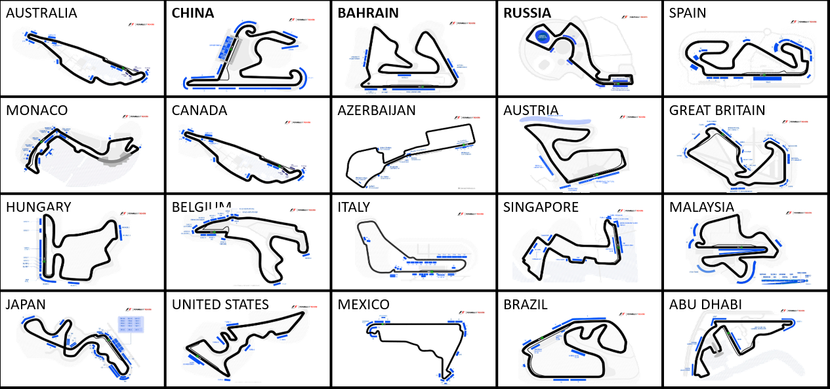
Formula One circuits

Slide 4
Formula One Yas Marina Circuit

Slide 5

Yas Marina Circuit
21 corners twist
Seating Capacity – 41,093
Area – 161.9 ha
Length – 5.5 km
Longest straight – 1140 metres

Slide 6

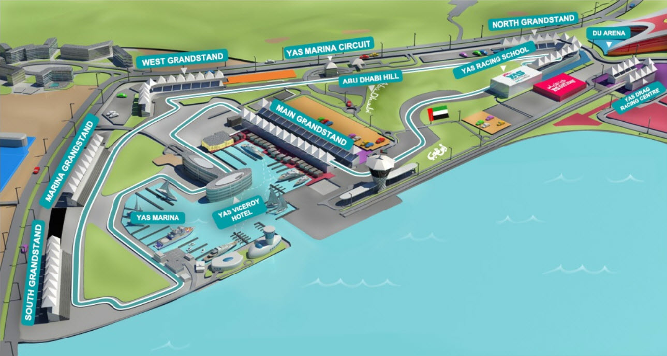




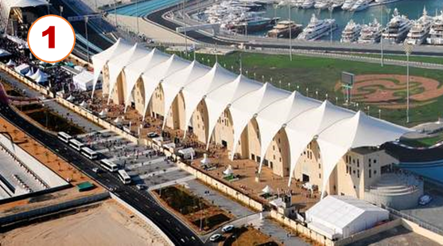
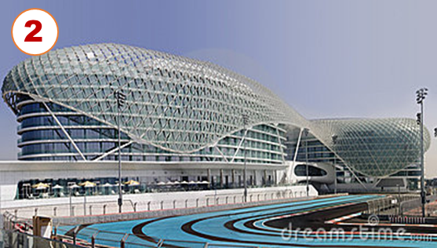
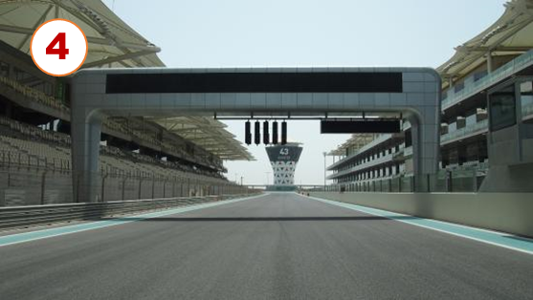
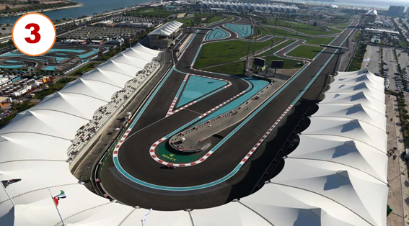
Design

Slide 7
2016 Driver Standings
See full championship standings

Slide 8
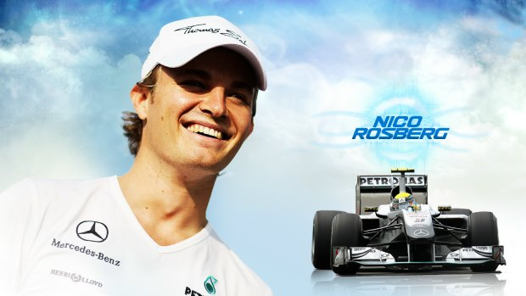
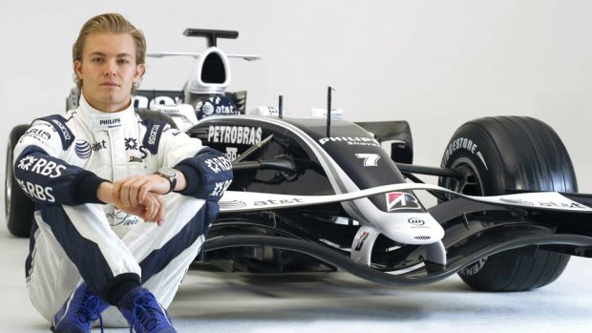
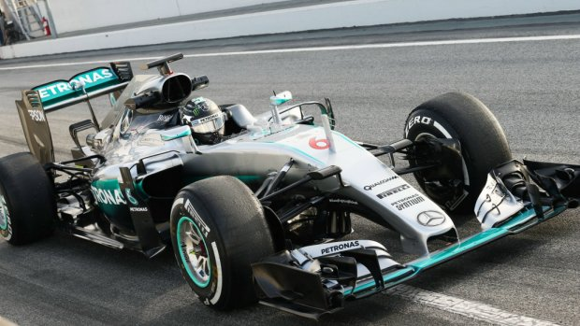
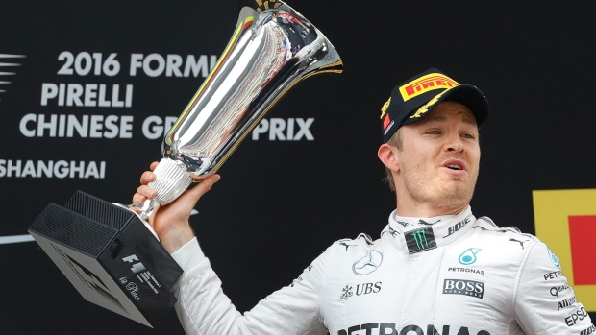
Nico Rosberg
Nico Rosberg celebrates winning the Formula One World Championship on the podium with Lewis Hamilton
New World Champion Nico Rosberg (GER) Mercedes AMG F1 celebrates by performing donuts on the track at Formula One World Championship, Rd21, Abu Dhabi Grand Prix, Race, Yas Marina Circuit, Abu Dhabi, UAE, Sunday 27 November 2016. Nico Rosberg's decision to retire at the age of 31, just days after winning the Formula One World Championship, stunned the sport.

Slide 9
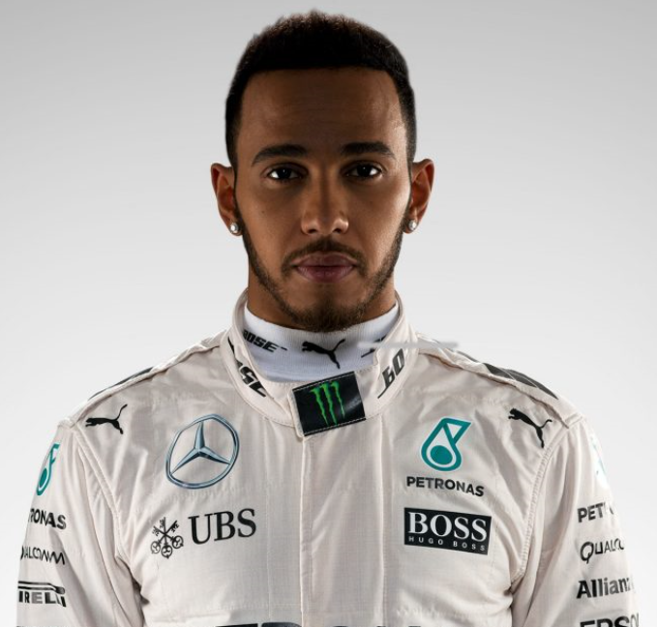
LEWIS HAMILTON
Notes:
Team Mercedes
Country United Kingdom
Podiums 104
Points 2247
Grands Prix entered 188
World Championships 3
Highest race finish 1 (x53)
Highest grid position 1
Date of birth 07/01/1985
Place of birth Stevenage, England

Slide 10
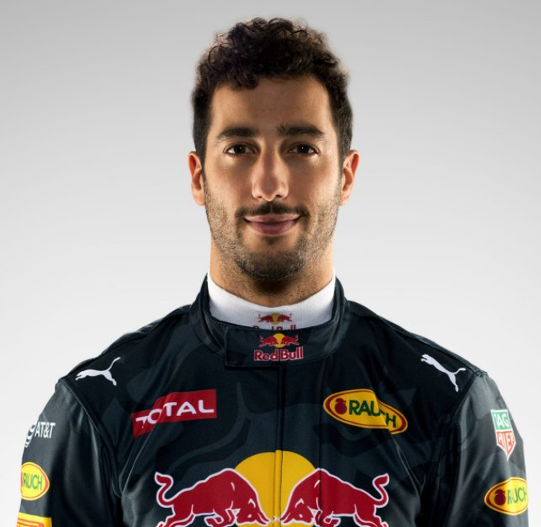
DANIEL RICCIARDO
Notes:
Team Red Bull Racing
Country Australia
Podiums 18
Points 616
Grands Prix entered 109
World Championships 0
Highest race finish 1 (x4)
Highest grid position 1
Date of birth 01/07/1989
Place of birth Perth, Australia

Slide 11
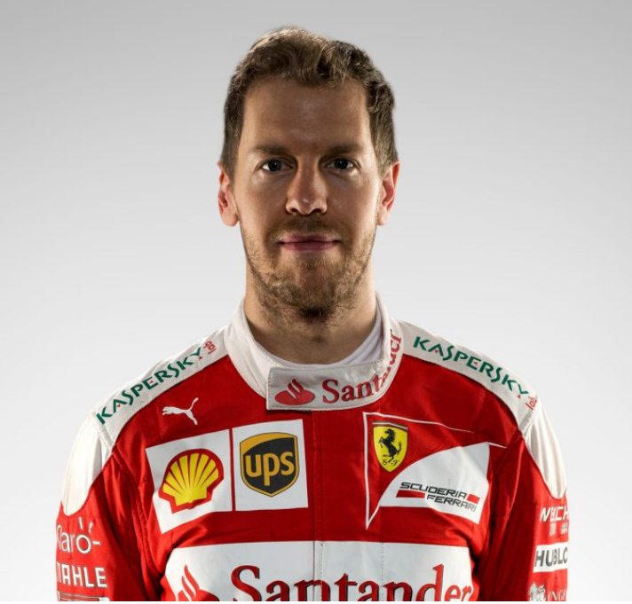
SEBASTIAN VETTEL
Notes:
Team Ferrari
Country Germany
Podiums 86
Points 2108
Grands Prix entered 179
World Championships 4
Highest race finish 1 (x42)
Highest grid position 1
Date of birth 03/07/1987
Place of birth Heppenheim, Germany

